Slide 1
Research on Blind Deblurring
GROUP 3
Yifeng Huang, Zijian Qiao
Yunzhe Cao, Shangru Huang

Slide 2
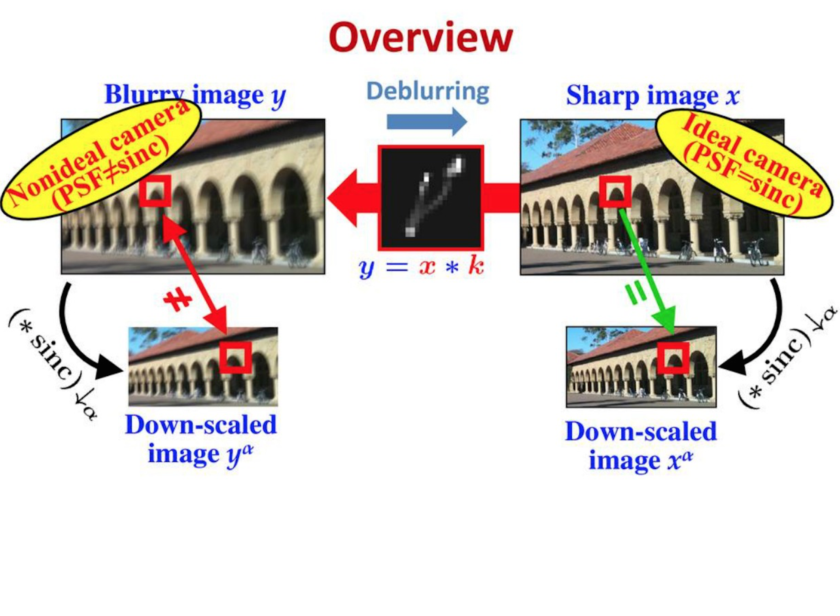
Blind Deblurring Using Internal Patch Recurrence
Property: For nature images, small patches tend to recur within multiple scales.
Solution: Use patches to compute the blur kernel K and then reconstruct the original image
http://videolectures.net/eccv2014_michaeli_blind_deblurring/

Slide 3
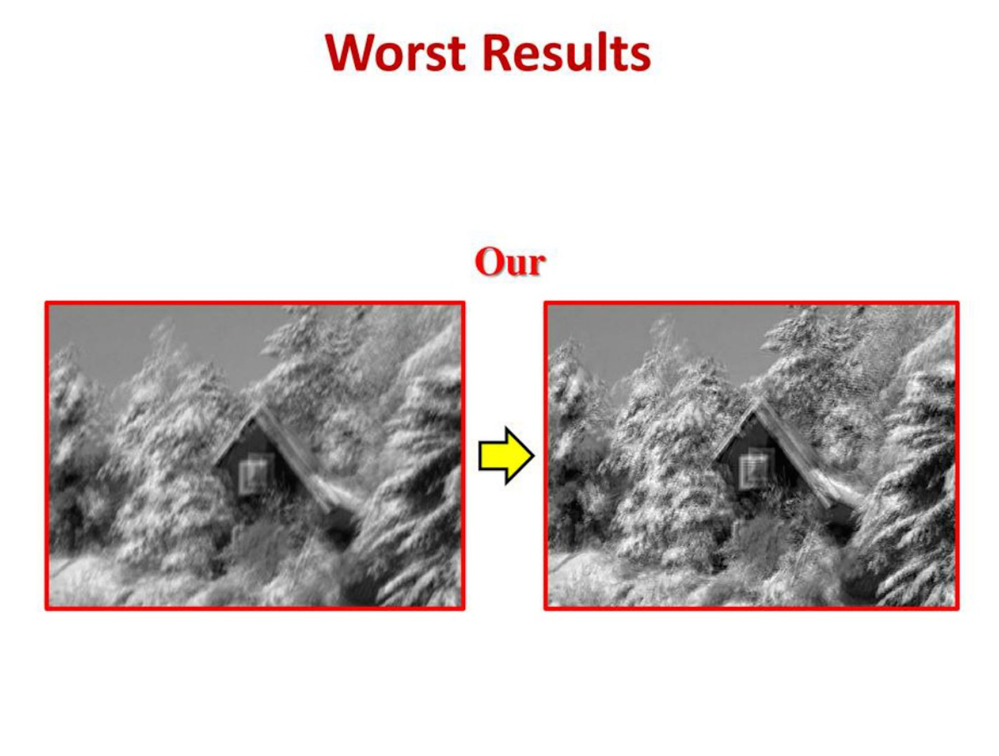
How to improve?
http://videolectures.net/eccv2014_michaeli_blind_deblurring/

